Slide 1

MVC Pattern with Django
Notes:
In this presentation, we will explore the MVC architectural pattern and its application in Django web development. We will also delve into Callbacks and Promises, fundamental concepts for asynchronous programming, and understand their significance in Django. Finally, we will explore real-life examples to solidify these concepts.

Slide 2
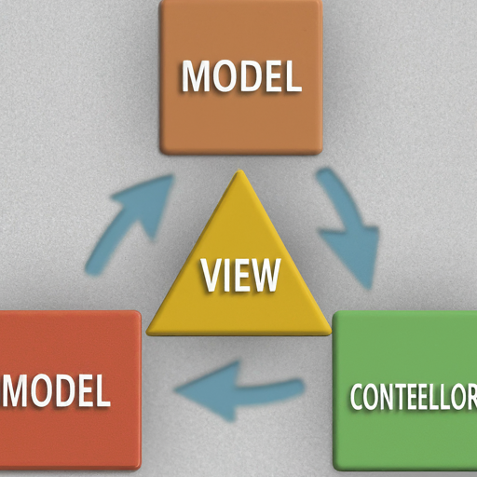
Introduction to MVC Pattern
The Model-View-Controller (MVC) is a popular architecture for structuring applications, especially web applications.
It separates the application into three key parts:
Model: Represents data and business logic (data storage, retrieval, calculations).
View: Presents data to the user (formatting data using HTML templates).
Controller: Intermediary between model and view (handles user input, interacts with model, instructs view).
Notes:
The MVC pattern promotes separation of concerns, reusability, and testability. While Django doesn't strictly enforce MVC, it provides tools and conventions to follow it and create well-structured web applications.

Slide 3

Benefits of MVC
Separation of Concerns: Code is clean and organized, easier to maintain and understand.
Reusability: Models and views can be reused across different parts of the application.
Testability: Each MVC component can be tested independently, making unit testing easier.
Notes:
The MVC pattern offers a structured approach to web development, promoting cleaner code, efficient reuse of components, and facilitating the creation of robust and maintainable web applications.

Slide 4
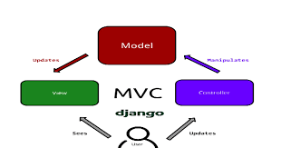
How MVC Works in Django
User visits a product listing page.
Controller (Django view) handles the request.
Controller interacts with the Model: retrieves product data from the database using Django ORM.
Controller prepares the View: populates an HTML template with product data.
View is rendered: The HTML template is rendered and sent back to the user's browser.
Notes:
This is a simplified example of how MVC separates concerns in a Django application. The controller acts as an intermediary, fetching data from the model and delivering it to the view for presentation.

Slide 5
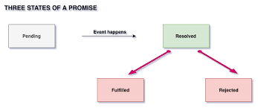
Understanding Callbacks and Promises
Callbacks and Promises are fundamental concepts for asynchronous programming.
Callbacks: A function passed as an argument to another function. It's invoked after the first function completes its asynchronous task and receives the result (or error).
Promises: An object representing the eventual completion (or failure) of an asynchronous operation. It has three states: Pending, Resolved, Rejected.
Notes:
Callbacks and Promises are essential for managing asynchronous operations, where a program can continue executing without waiting for a long-running task to finish. This is crucial for responsive web applications.

Slide 6
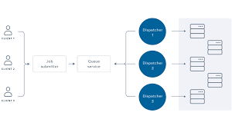
Importance of Async Operations in Web Development
Web development heavily relies on asynchronous operations due to the interactive nature of web applications and communication with external resources.
Callbacks and Promises for Non-Blocking I/O: Traditional synchronous programming involves blocking I/O operations, halting program execution until the I/O operation finishes.
Callbacks and Promises in Django: Django supports asynchronous operations through callbacks and other mechanisms.
Notes:
Asynchronous operations are essential for web applications to remain responsive while fetching data or interacting with external resources. Callbacks and Promises provide mechanisms to handle these asynchronous operations effectively.

Slide 7
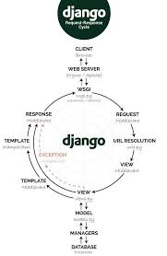
Callbacks in Django
Asynchronous Tasks: Django provides libraries like django.core.signals and third-party libraries like Celery to define tasks executed asynchronously. These tasks can be triggered by events and often involve callbacks.
Signals: Django's signal system allows you to connect functions (callbacks) to be executed when specific events occur within the framework. For example, you could define a callback to be triggered after a user is saved, allowing you to perform additional actions like sending an email notification.
Notes:
In Django, we can leverage callbacks to handle asynchronous tasks. These tasks run in the background without blocking the main request-response cycle. There are two main approaches to using callbacks for asynchronous operations in Django:
Asynchronous Tasks with Libraries: Libraries like django.core.signals and Celery allow you to define functions to be executed asynchronously. These tasks can be triggered by events within your Django application, such as a user saving data. When such an event occurs, the library will invoke the predefined callback function to handle the task in the background. This is a powerful approach for handling long-running operations that don't require immediate user interaction.
Django Signals: Django's built-in signal system allows you to connect functions (essentially callbacks) to specific events or signals emitted by the framework itself. For instance, you can define a callback function that gets triggered after a user is saved. This callback can then be used to perform secondary actions like sending an email notification or updating related data. This approach is useful for reacting to framework events and performing additional actions asynchronously.
By effectively using callbacks with asynchronous tasks and signals, we can create responsive and performant Django applications that can handle complex workflows without hindering the user experience.

Slide 8
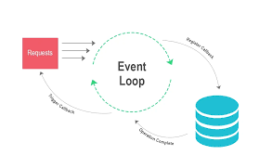
Non-Blocking I/O with Callbacks
Database Operations: Although Django provides an ORM for database access, some operations might involve raw SQL queries. Libraries like asyncpg allow for asynchronous database interactions using callbacks. You can initiate the query and define a callback to receive the results later without blocking the main thread.
Notes:
While Django offers an Object-Relational Mapper (ORM) for simplified database interactions, there might be scenarios where raw SQL queries are necessary. In such cases, libraries like asyncpg come into play. asyncpg enables asynchronous database interactions using callbacks. You can initiate the SQL query and define a callback function to handle the results once they become available. This approach prevents the main thread from being blocked while waiting for the database operation to complete, improving the overall performance and responsiveness of your Django application.
By leveraging callbacks with asynchronous database operations, you can ensure that your Django application remains efficient and maintains a seamless user experience even when interacting with databases.

Slide 9

Limitations of Callbacks
Callback Hell: As the number of asynchronous operations and nested callbacks increases, code can become difficult to read and maintain, known as "callback hell."
Notes:
While callbacks offer a way to handle asynchronous operations, their extensive use can lead to a situation known as "callback hell." This occurs when you have multiple asynchronous operations stacked within one another, using nested callbacks. The resulting code structure becomes convoluted and challenging to understand, debug, and maintain. Imagine a bunch of tangled spaghetti!
To avoid callback hell, it's essential to be mindful of the number of nested callbacks used in your Django application. Consider alternative approaches like Promises or Async/Await (covered in the next slide) for more complex asynchronous workflows. These approaches can provide a clearer and more maintainable way to handle asynchronous operations in your Django code.

Slide 10
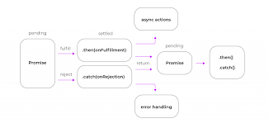
Alternatives to Callbacks
Async/Await: While not directly built-in, Python 3.5+ introduces async and await keywords for writing asynchronous code. This syntax offers a more readable and sequential approach compared to callbacks. Third-party libraries like Django Channels can be integrated with Django to enable writing asynchronous views and handlers using async/await.
Notes:
In this presentation, we will explore the MVC architectural pattern and its application in Django web development. We will also delve into Callbacks and Promises, fundamental concepts for asynchronous programming, and understand their significance in Django. Finally, we will explore real-life examples to solidify these concepts.

Slide 11
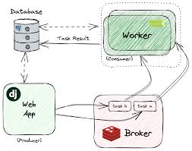
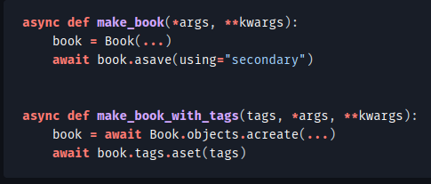
Django Code Demo
Showcasing the MVC pattern and Callback with Django

Slide 12
Thank you
Dhiraj Patra
https://dhirajpatra.blogspot.com

